Slide 1

Project C Provincial Disaster Management Authority (PDMA) Disaster Management System © 2010 FAST07DMS Version 1.0

Slide 2
Project Overview
Disaster management system is a system to support the activities related to prediction, damage assessment and rehabilitation phases of a disaster.
Bring together actors from Government, Emergency Management, NGOs, INGOs, spontaneous volunteers and victims themselves on one platform.

Slide 3
Project Modules
SMS alert system – awareness of disaster through SMS.
2. Training management module – management of data pertinent to trainings being carried out in case a disaster occurs.
3. Request Management System – management of all the requests registered by citizens during in a disaster.
4. Missing Person Registry – management of the complete information about people who are missing after a disaster.

Slide 4
Project Modules
5. Inventory Management System – to track the quantities, expiries of supplies stored for utilization in a disaster and generate reports.
6. Situation awareness – it is used to mark locations on the map that will be used to aid situations.
7. Volunteer management system – Allows managing volunteers by capturing their skills, availability and allocation.
8. Camp/Shelter Registry – tracks location and number of victims in various evacuation points and temporary shelters.
9. Organization Registry – provides interface for registering an organization, adding branch, updating information.

Slide 5
Benefits to Industry
PDMA will be able to provide and track relief activities to millions to people in Sindh.
Provides PDMA a platform for inter organizational data sharing during a disaster to provide relief effectively.
It is an open source and cost-effective solution for PDMA.
Use of Joomla makes this project extendable, via free online joomla extensions.

Slide 6
Project Methodology
Requirements were gathered on the basis of meetings held every week with a PDMA representative.
On the basis of requirements detailed structure of the module was designed.
Clears with time to time and client satisfaction increased as the work progressed.
On the basis of the documents produced, implementation took place.

Slide 7
ORGANIZATION REGISTRY
Organization can apply for registration online
Registered organization can add branch
Organization can update information
PDMA admin will be able to confirm registration of an organization
PDMA admin can search any organization based on information
PDMA admin can see the information of any registered organization
Login credentials will be used to identify the users

Slide 8
VOLUNTEER MANAGEMENT
Volunteer Registration
News Updates
Search
View Profile
Update Profile
Assigning roles and Responsibilities

Slide 9
CAMP REGISTRY
Camp admin will first register a camp by providing location, capacity and basic facilities available.
Camp admin can request more facilities, resources and need of victims.
Organizations and management can search active camps to know the current situations.
Camp Manager can view reports.

Slide 10
INVENTORY MANAGEMENT
The System provides the following facilities to the system users:
• It store all the data placed at different location.
• It will handle all functions related to the tracking and management of stock.
• This would include the monitoring of material moved into and out of stockroom locations and the reconciling of the inventory balances.
• Facilitates easy inventory handling with reasonable catalog.
• Can perform various operations like add, delete, transfer, set relation and set alternate for many items and also generate different type of reports related to inventory items.
• Can order many Items at a time (no limit).
• On-line order tracking.

Slide 11
SITUATION AWARENESS
This module is an essential part of the Disaster Management System, it will help identify a situation an locate it on the map.
The system can be helpful incase of both natural and man made disasters.
System works when connected to the internet using the imagery by the Google map.
Only authorized user can gain access to the system and mark a situation.
The situations marked can then be viewed to aid the effected region accordingly.
The system will help in a unique way by providing the coordinates of the effected area.

Slide 12
MISSING PERSON REGISTRY
Missing person → register on webportal.
By himself
By relative
Also allows the search for missing person stored in database
person is found(alive or dead)→ record goes to list of particular type

Slide 13
TRAINING MANAGEMENT
Management of trainings conducted and trainings required all kinds of disasters
Making the PDMA officer’s job easy by including search option to find all trainings related to a particular disaster or district
Keeping a list of people trained personnel for separate disasters

Slide 14
SMS Alert System
SMS alert system is about to send SMS via GSM SIM to common people to make aware them of coming adversity so that they may save their lives. It’s also related to aware and instruct organization and volunteers about disaster and be alert for help. Last task is to send SMS high authority to inform about coming ruin so that they alert and plane to control and handle condition.

Slide 15
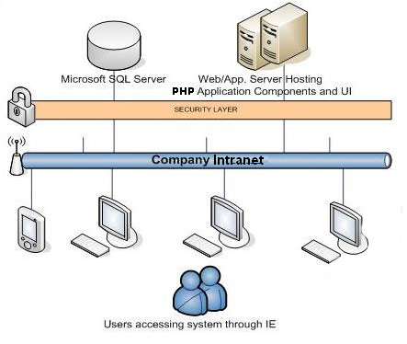
System Architecture

Slide 16
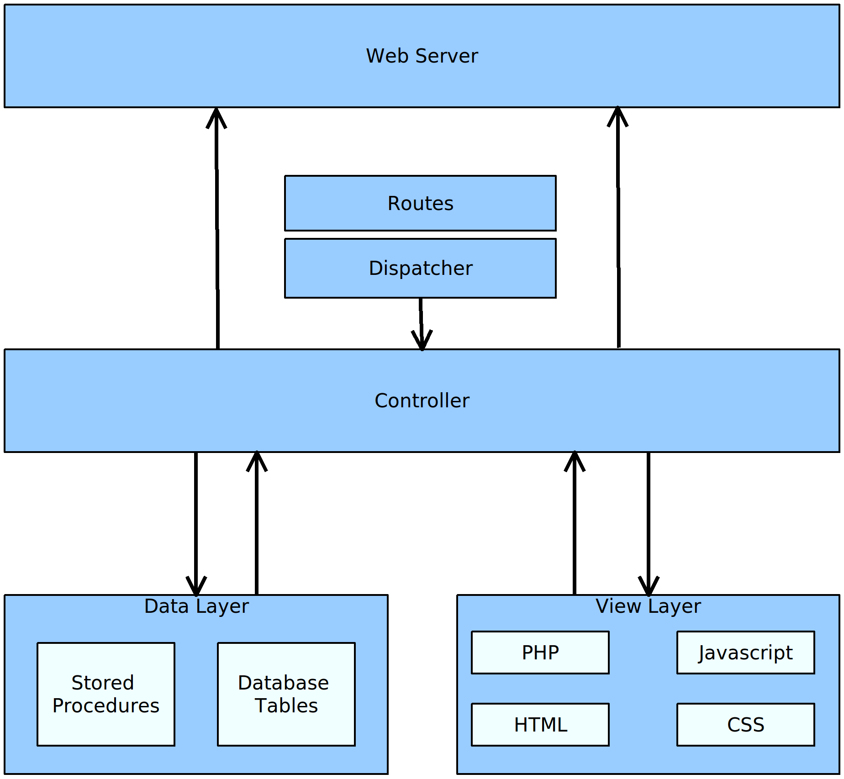
Software Architecture

Slide 17
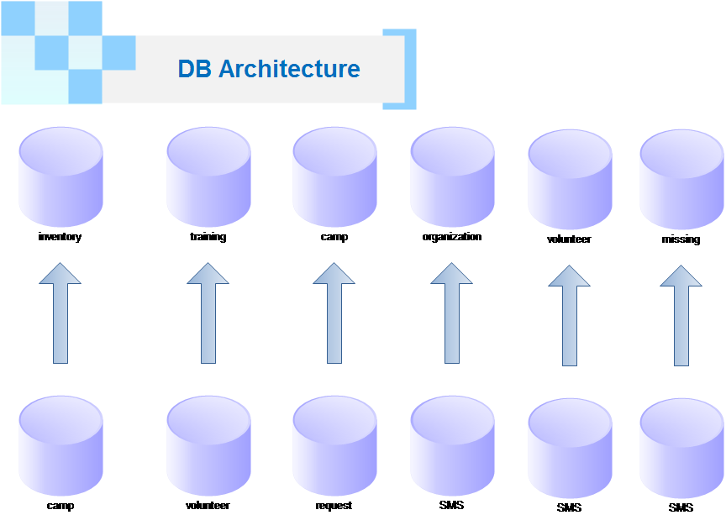

Slide 18
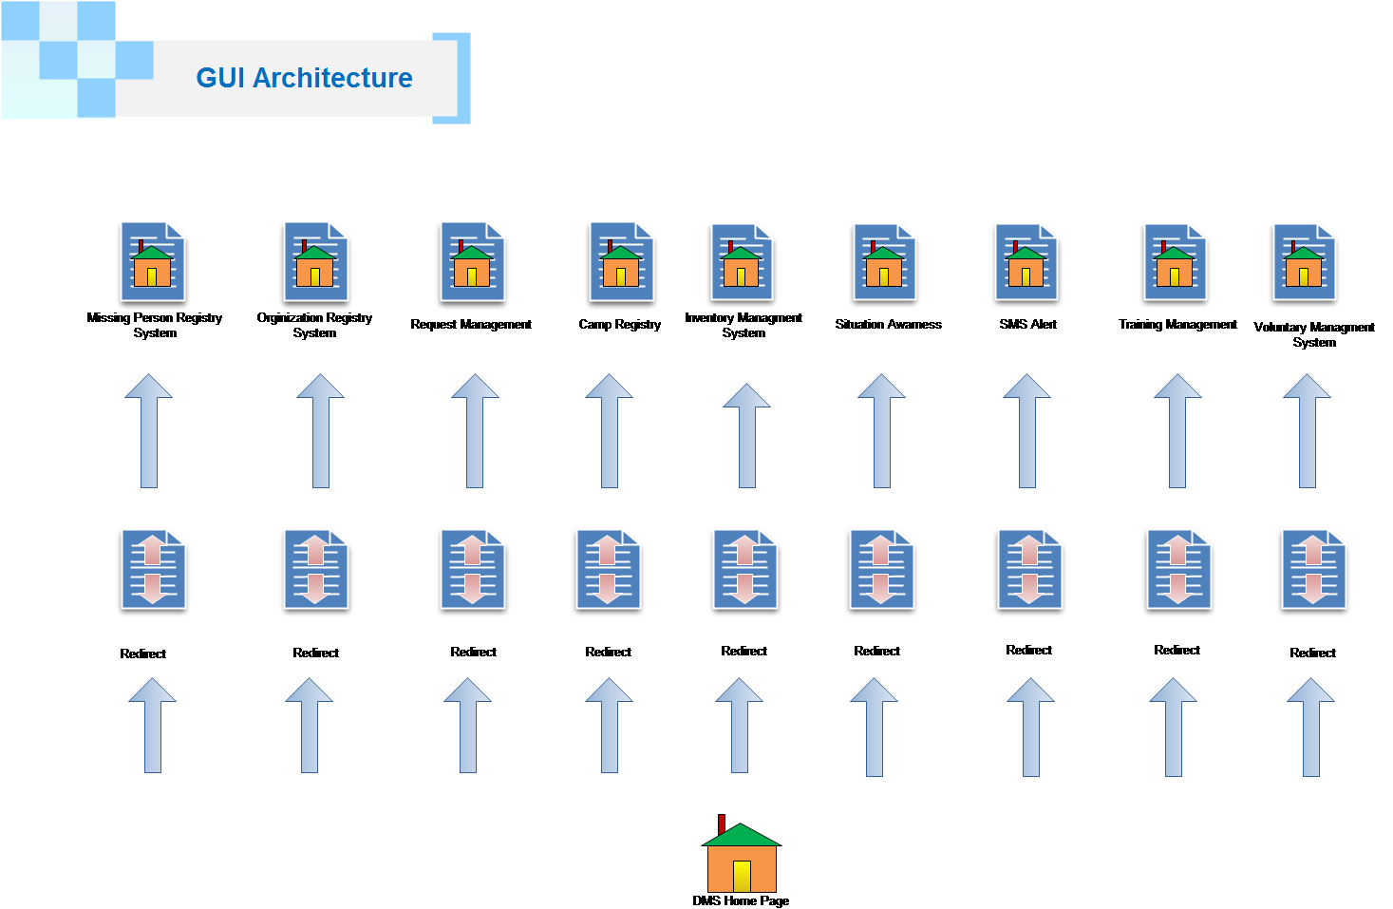

Slide 19
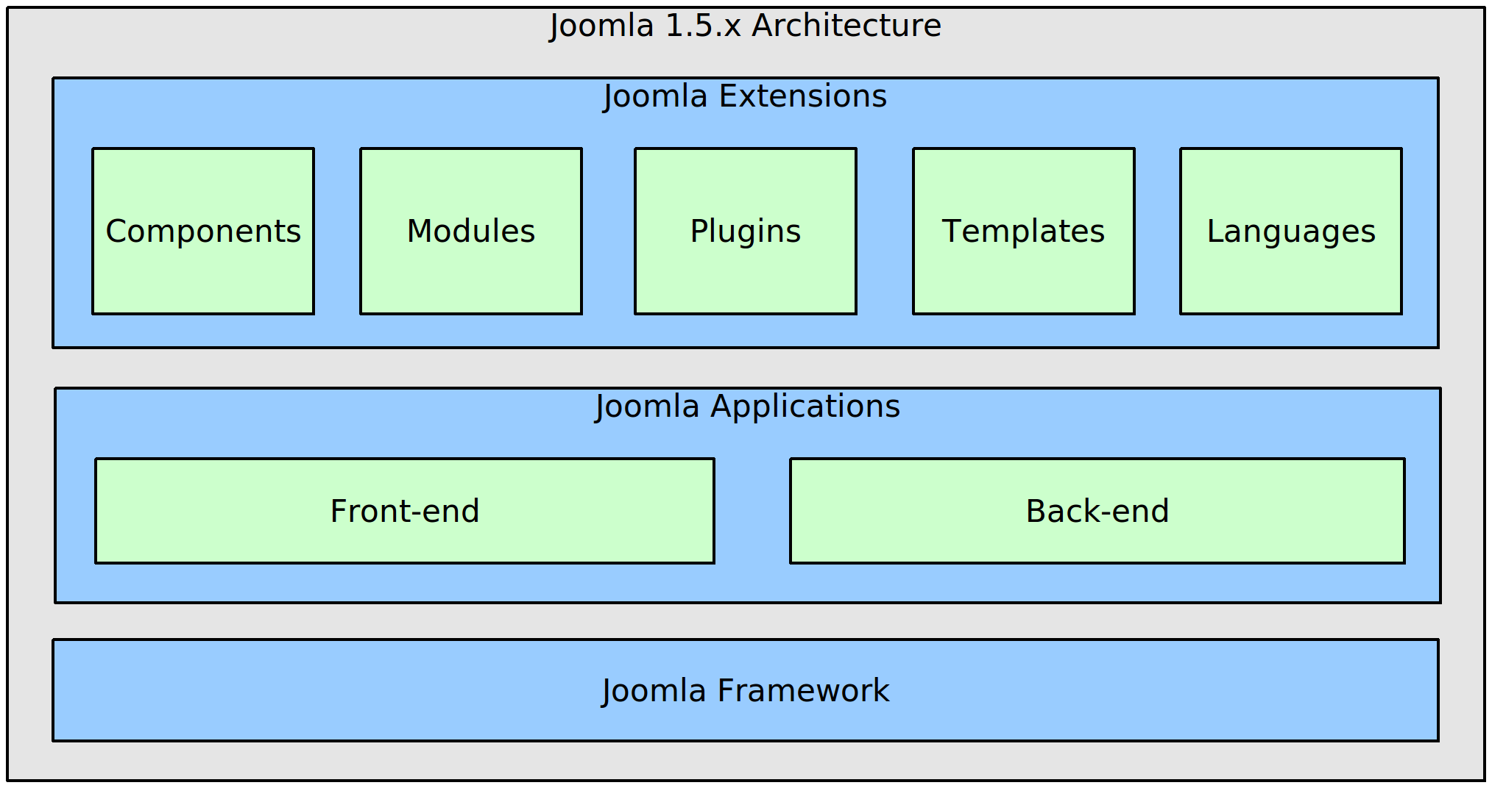
JOOMLA ARCHITECTURE

Slide 20
Project Risk areas & mitigation plan
These are some of the Major Risk which we have faced:
Schedule Risk
Schedule is the highest level of risk we have faced. As we are assumed to deliver DMS project with in
the given deadlines.
Resource Risk
While developing IMS we came up with various resource issues (like: a separate Server for all modules
of Disaster Management System, administrative rights issues)
Integration Risk
As this is our first project together. At the time of integration it will be a problem as we don’t have
enough experience and don’t know what type of integration problems are.
Technical Risk:
During the development of the project we have faced different types of technical risks
like: lack of technical expertise in joomla, php, Ozeki server.

Slide 21
Project management strategies
Throughout the making of this project we all worked together as a team.
We distributed the project into different tasks and each task is assigned to a group member.
To make the communication path more reliable and easy, we created a google group where all sub-groups did discussion.
Weekly meetings with Mr. Mehraab Puri and other sub-groups who have some issues regarding DMS.

Slide 22
Project Management strategies
When a project requires significant time and resources, the best place to begin is gathering the tools and materials needed for the project
Identify the goals of the stakeholders and sponsor.
PDMA mangers were communicated by our groups and goals were developed that were realistic attainable
and well communicated.
Assess our own capabilities and limitations
Further we analyzed within our self what programming language and environment was well suited for
development of the project . JOOMLA was decided as the working environment and discussed with other
groups and sponsor.
Define the problem
Documentation such as SDS SRS and work break down structure was written to define the goal risk and
relationship of different task discussed an to be developed in the module
Develop solutions
Breaking the task into different sub modules and given to each group member to develop and implement
and discuss any constraints. We created an action plan involving deadlines to submit assigned task to the
group leader by the members.
Test and refine the solutions
Any new learning was incorporated at the end . As the development progresses any new idea or constraint
was re plan or re thought.

Slide 23
Lesson Learnt
Requirement gathering is most important piece of any application development. Requirements analysis is critical to the success of a development project.
Its very important to communicate with your team members. A lack of communication can lead to the failure of the project.
When project is almost done review it. If you notice that something's wrong, you must inform your team and correct the errors.
Time management is important. You must know how you use time during project.
The client should be informed about the limitations as their
requests may some times be impossible to accommodate.

Slide 24
Issues faced
Gathering the requirements from client on weekly basis was a difficult task.
Client is not a part of developing team.
Each member must work on the same platform/ framework.
Assigning the Tasks according to the skills.
Client was not aware of shortage of time and burden of other courses.
Using JOOMLA for integration was not compatible with all the groups.

Slide 25
Open Issues
Integration is still not up to the mark.
Validations and authentication need to be improved more.
Increments will definitely help to improve the functionality of project.

